Slide 1
What on earth is Spondyloarthritis?
DANIEL MURPHY
GP HONITON SURGERY
STAFF GRADE RHEUMATOLOGIST royal DEVON and Exeter hospital
RCGP CLINICAL CHAMPION INFLAMMATORY ARTHRITIS

Slide 2
Outcomes
What is spondyloarthritis?
How do I recognise it?
What if I suspect it?

Slide 3
What is axial Spa?
Chronic inflammatory condition affecting spine and sacroiliac joints
    Characterised by chronic back pain & stiffness
Enthesitis
Peripheral joints
Extra-articular disease
Often a family history

Slide 4

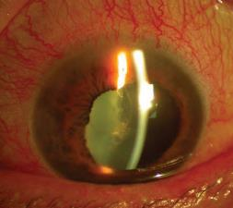
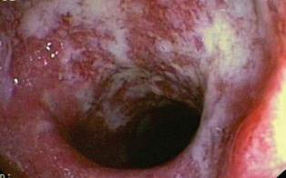
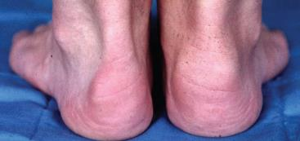
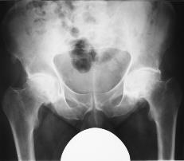
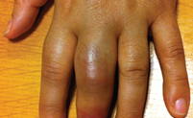
Extra-articular manifestations of axial SPA
Psoriasis
Anterior uveitis
Inflammatory bowel disease
Dactylitis
Enthesitis right heel
Peripheral Arthritis
Stolwijk C et al. Ann Rheum Dis 2015;74:65-73; Essers et al. Rheumatology 2015;54:633-40

Slide 5
Spondyloarthritis
Shared
Psoriasis
infection
Clinical Features
Radiological
Genetic (HLA-B27)
Therapy
Axial SpA
IBD
uveitis
Notes:
The term SpA refers to a group of inflammatory conditions with shared clinical features …. And in which spinal involvement is prominent

Slide 6
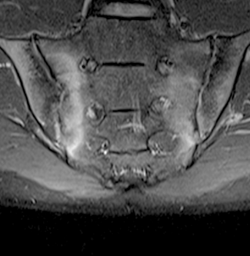
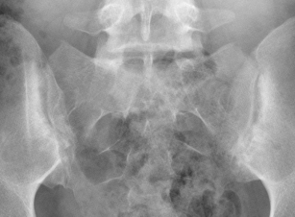
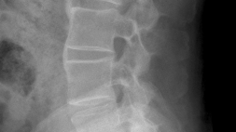
Why bother changing the name?
Axial SpA
Ankylosing spondylitis
Non-radiographic stage
X-ray-negative
Radiographic stage
X-ray-positive sacroiliitis
MRI positive
sacroiliitis
Radiographic stage
X-ray-positive sacroiliitis
and/or spinal changes***
Estimated proportion of affected individuals*
Time
Images reproduced with permission
Notes:
It is now clear that there is a spectrum of axial spondyloarthritis. The centre and right panels indicate that some patients have radiographic sacroiliitis and a proportion of these also have typical radiographic changes in the spine. These fulfil the criteria for AS. The left hand panel, however, indicates that a greater number of patients have evidence of sacroiliitis present only on MRI scanning. Not all these progress to radiographic disease. There appears to be a small subgroup in whom MRI scanning is negative but in whom the diagnosis of axial spondyloarthritis can be based on clinical criteria and the presence of HLA-B27.
Reference
Sieper J, van der Heijde D. Review: Nonradiographic axial spondyloarthritis: new definition of an old disease? Arthritis Rheum 2013;65:543–51

Slide 7
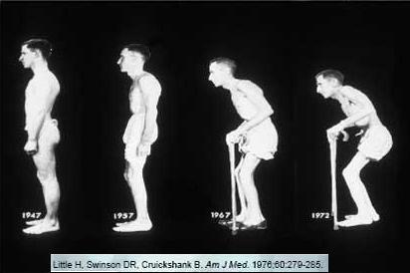
Why bother changing the name?
Axial SpA
Ankylosing spondylitis
Non-radiographic stage
X-ray-negative
Radiographic stage
X-ray-positive sacroiliitis
Radiographic stage
X-ray-positive sacroiliitis
and/or spinal changes***
Estimated proportion of affected individuals*
Time
Images reproduced with permission
Notes:
It is now clear that there is a spectrum of axial spondyloarthritis. The centre and right panels indicate that some patients have radiographic sacroiliitis and a proportion of these also have typical radiographic changes in the spine. These fulfil the criteria for AS. The left hand panel, however, indicates that a greater number of patients have evidence of sacroiliitis present only on MRI scanning. Not all these progress to radiographic disease. There appears to be a small subgroup in whom MRI scanning is negative but in whom the diagnosis of axial spondyloarthritis can be based on clinical criteria and the presence of HLA-B27.
Reference
Sieper J, van der Heijde D. Review: Nonradiographic axial spondyloarthritis: new definition of an old disease? Arthritis Rheum 2013;65:543–51

Slide 8
Interval between symptom onset and
first consultation with GP in patients with AS
Time
Hamilton L. et al. Rheumatology 2011;50:1991–1998.

Slide 9
Time to diagnosis of axSpa
9 years in 2000¹
8.57 years in 2011²
8.5 years in 2015³
5.72 years in 2014⁴
Feldkeller E et al. Curr Opin Rheumatol 2002;12:239-247.
Hamilton L, K Gaffney et al. Rheumatology (Oxford) 2011;50:1991-1998.
Sykes M, Gaffney K. Rheumatology (Oxford). 2015 54(12):2283-4 .
Jones A et al. Rheumatology (Oxford) 2014;53:2126-2127.
Notes:
Karl will discuss limitations of data

Slide 10
Ax-spa summary
AxSpA is
  complex disease
  A relatively uncommon cause of a very common symptom
Poor awareness¹
Examination often unhelpful
Difficult to reach the right expert²
Jois RN, Gaffney K. Rheumatology 2008;47(9):1364–6
Hamilton L, Gaffney K et al. Rheumatol 2011; 50:1991–1998

Slide 11
How do I diagnose spa?

Slide 12
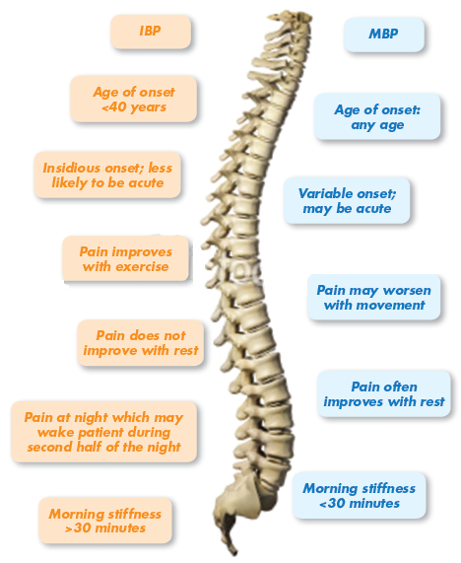
Comparison of inflammatory and mechanical back pain
Sieper J et al. Ann Rheum Dis 2009;68:ii1–ii44.

Slide 13
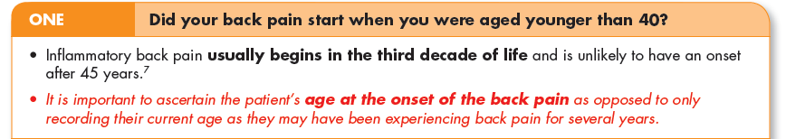
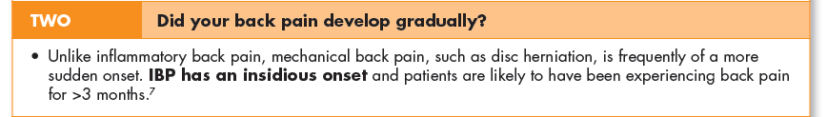

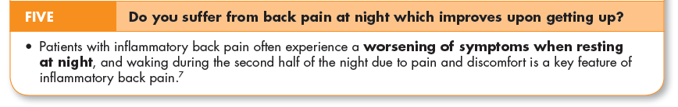
Asas inflammatory back pain criteria
1
1
1
1
Inflammatory back pain requiring further investigation is usually indicated if the answer is ‘yes’ to 4 or more of these parameters

Slide 14
Nice guidance

Slide 15
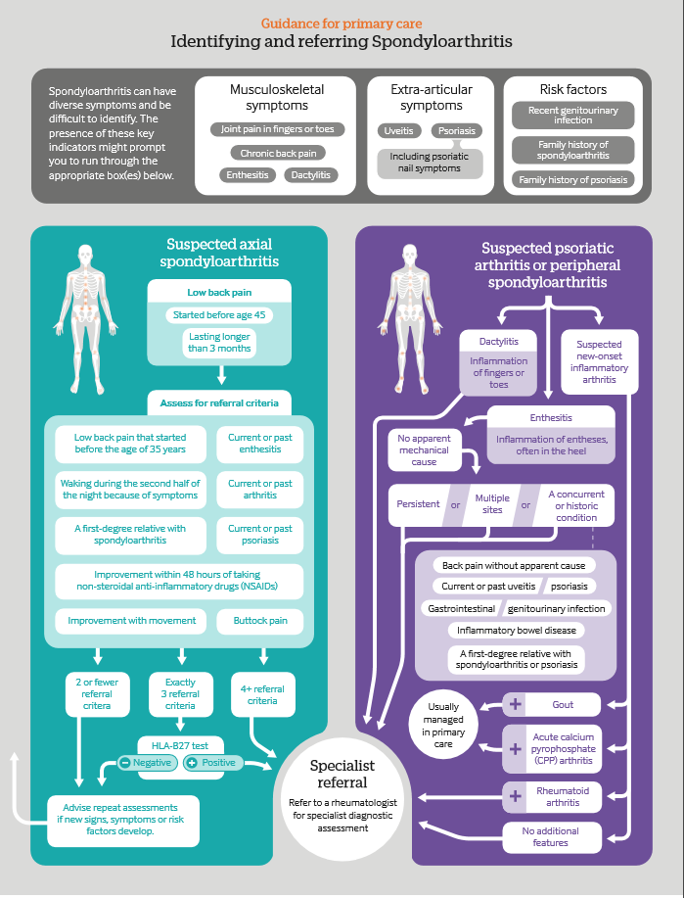

Slide 16
Nice guidance..
SpA…
Affects a similar number of women as men
Can occur in people who are human leukocyte antigen B27 (HLA-B27) negative
May be present despite no evidence of sacroiliitis on a plain film X-ray.

Slide 17
What to do if I suspect SPA?

Slide 18
summary
AxSpA is a complex disease
Unacceptable delay to diagnosis
History is key to diagnosing early – investigations seldom helpful

Slide 19
Thank you
danielmurphy@nhs.net
@drdannymurphy

